Slide 1
Preparing to write the CHRP-KE or CHRL-KE:
Advice from the Registrar
Feb 10, 2022

Slide 2
Claude Balthazard, Ph.D., C.Psych., CHRL
Registrar and Vice-president Regulation
Human Resources Professionals Association
cbalthazard@hrpa.ca
416-272-9750

Slide 3
Kelly Morris, CHRL
Exams Manager
Human Resources Professionals Association
kmorris@hrpa.ca
416-923-2324 x342

Slide 4
Thomas Callitsis
Exams Specialist
Human Resources Professionals Association
tcallitsis@hpra.ca
416-923-2324 x301

Slide 5
Housekeeping
Webinar will be recorded and posted online
This webinar is NOT eligible for CPD

Slide 6
Questions Involving Specific Individual Circumstances
This webinar is not the appropriate place and time to address specific individual circumstances
Sometimes the correct answer depends on details that are not provided with the question
Please contact the Office of the Registrar registrar@hrpa.ca or exams@hrpa.ca with questions involving specific individual circumstances

Slide 7
Agenda
The seven pieces of advice:
Go to the source
Understand how the exams were developed
Develop a plan
Choose exam prep methods that are right for you
Develop multiple-choice test-taking skills, but avoid ‘tricks’
Learn to manage exam anxiety
Remote proctoring or test centre?

Slide 8
Advice #1: Go to the source
The first piece of advice is to get your information about the exams from the source—this means HRPA’s website or Office of the Registrar staff.
We know that many exam candidates get their information from course instructors and others. Although these individuals are well-meaning, we have found that some of their advice is either outdated or incorrect.
We know that many exam candidates get their information from social media groups i.e. Facebook groups. Although these individuals are well-meaning, we have found that some of their advice is incorrect. Exam candidates who have written exams are bound by a non-disclosure agreement and cannot reveal the content or provide hints about content of any exams to anyone on a study group.
The reality is that anyone who has anything to do with the content of the exams is bound by a non-disclosure agreement.

Slide 9
Who really knows what is on the exam?
HRPA’s psychometrician John Wickett of Wickett Measurement Systems, Inc.
Members of the CHRP and CHRL Exam Validation Committees
Kelly Morris, HRPA’s Exams Manager
Thomas Callitsis, HRPA’s Exams Specialist

Slide 10
Confidentiality agreement
All exam candidates agree to maintain the confidentiality of the exams as one of the terms and conditions of writing the exam and sign a non-disclosure agreement
There are multiple forms of the exam in each administration window
The content of the exam is refreshed for each administration
Hearing what previous exam candidates might remember of the exam is not likely to be useful to you and violates this agreement
Consequences of violating this agreement could result in disciplinary action, a referral to HRPA’s complaints committee or the nullification and/or voiding of exam results

Slide 11
Be wary of those who offer advice
HRPA provides a lot of information on its exams
There is no ‘insider information’
No one or no organization has access to better or more accurate information than you do
So, be careful out there

Slide 12
Advice #2: Understand how the exams were developed
The CHRP-KE and CHRL-KE measure basic knowledge in HR—the kind of knowledge candidates would be expected to have in order to be able to demonstrate the competency
Basic knowledge… not competence

Slide 13
HRPA publishes a lot of information about its exams
HRPA Human Resources Professional Competency Framework
Exam blueprints
Question-writing style guidelines
Technical manuals for previous administrations
Webinars on exam development process
Webinars on eligibility requirements for exams
Webinars on remote proctoring

Slide 14
Where do the questions come from?
The questions are written by subject matter experts that can include course instructors—diploma course instructors and degree course instructors and HR Professionals who currently practice in the field
The questions are referenced to the competencies in the HRPA Human Resources Professional Competency Framework. Question writers start from a given competency and then consider the knowledge would be required to be able to demonstrate the competency

Slide 15
Style guide
All questions are in the same four-option multiple-choice format
No ‘all of the above’
No ‘none of the above’
No ‘a and b are true’
No double negatives
No negative questions
No trick questions

Slide 16
Multiple layers of review
All CHRP-KE and CHRL-KE questions are reviewed for adherence to style guidelines
All CHRP-KE and CHRL-KE questions are reviewed for having one and only one correct answer. All questions are fact checked independently, meaning that correctness of the correct option and the incorrectness of the incorrect options is verified against commonly used textbooks
Questions are reviewed by a copy editor for consistency of grammar and style
Questions are then reviewed and validated by HRPA’s Exam Validation Committees

Slide 17
Exam blueprints and exam assembly
The exam blueprints provide a listing of the major content areas and cognitive levels intended to be included on each exam form. It also includes the number of questions each exam form should include within each of these content and cognitive areas
All our exam blueprints are published on the HRPA website
The CHRP and CHRL Exam Validation Committees use the exam blueprints as their guide to assemble exam content
Care is taken that there are no ‘enemy questions’

Slide 18
Post-exam review
Despite all the layers of review, sometimes questions don’t work like they are supposed to
After each administration, questions are reviewed based on psychometric performance criteria by our psychometrician John Wickett
Members of the Exam Validation Committee are convened to review the results with our psychometrician—this process is called key validation

Slide 19
Floating pass scores
There is no target pass rate
The pass score is set for each form of the exam to reflect the same level of proficiency
This is fine-tuning to ensure that the pass-score is set at the same level of proficiency every time (the number of questions to be answered correctly may vary somewhat, but the level of proficiency required to pass the exam does not change from one form to the next)
Notes:
This only applies to the CHRP KE and not the CHRL-KE. I know we explain this on the next slide, so perhaps provide some clarity here

Slide 20
Compensatory and non-compensatory scoring
Compensatory scoring means that a high score in one sub-domain will compensate for a low score in another. It’s the total score that counts. The CHRP-KE has compensatory scoring
Non-compensatory scoring means that in addition to a overall cut-score, there is a cut-score for each sub-domain. The CHRL-KE has non-compensatory scoring
Non-compensatory scoring is like the coursework requirement—a 70% average across all nine courses but with no single course under 65%

Slide 21
Compensatory and non-compensatory scoring
If you are writing the CHRL-KE it is important to work on your weak subjects

Slide 22
Advice #3: Develop an exam preparation plan
The plan should address content, process, and testing environment
Conduct a self-assessment
Assess your knowledge in the different functional areas

Slide 23
Conduct a self-assessment
What has been your experience with important exams?
What has worked for you and what hasn’t?
How would you assess your current level of knowledge in each functional area?
Review the functional areas and competencies in the Competency Framework to identify the areas where you feel strongest and those which would benefit more from extra study
Use the functional competencies matrices at the end of the Framework for added information about what is intended by each competency
Some competencies are not covered on the CHRP-KE and that is noted in the matrices and on the CHRP-KE blueprint

Slide 24
Knowledge
It is about facts
Coverage is important
Textbooks
in reviewing textbooks remember it is about facts
the depth of knowledge comes from the relevant HR textbooks- these same textbooks were used when you took the HR courses
not required to purchase new textbooks – use the textbooks you already have
one textbook is not sufficient to cover the depth of knowledge required for the knowledge exams
Consider glossaries
Perhaps the most underutilized strategy
Human Resources has a lot of specialized terminology
If you can define all the specialized terms and describe of how each relates to other specialized terms you are likely in good shape
Notes:
Not sure what is meant by this highlighted point. Provide further clarity

Slide 25
Acquiring and retaining the relevant knowledge
Plan to review it all
But if time is short focus on the functional areas where you are weakest and use the Competency Framework as a guide to further focus your studying

Slide 26
Is it possible to study too much?
Yes, but it is highly variable from person to person and the intensity of the studying and how long ago you completed your coursework
Three-months may be the optimum & develop a schedule over this time and pace yourself accordingly.
Pacing is important here
Carve out some extra time for studying just before test day

Slide 27
Advice #4: Choose exam prep method(s) that are right for you
Let’s review the pros and cons of the following exam prep methods:
Self-study
Study groups
One-on-one mentoring
College and university test centres prep programs
Prep programs

Slide 28
Self-study

Slide 29
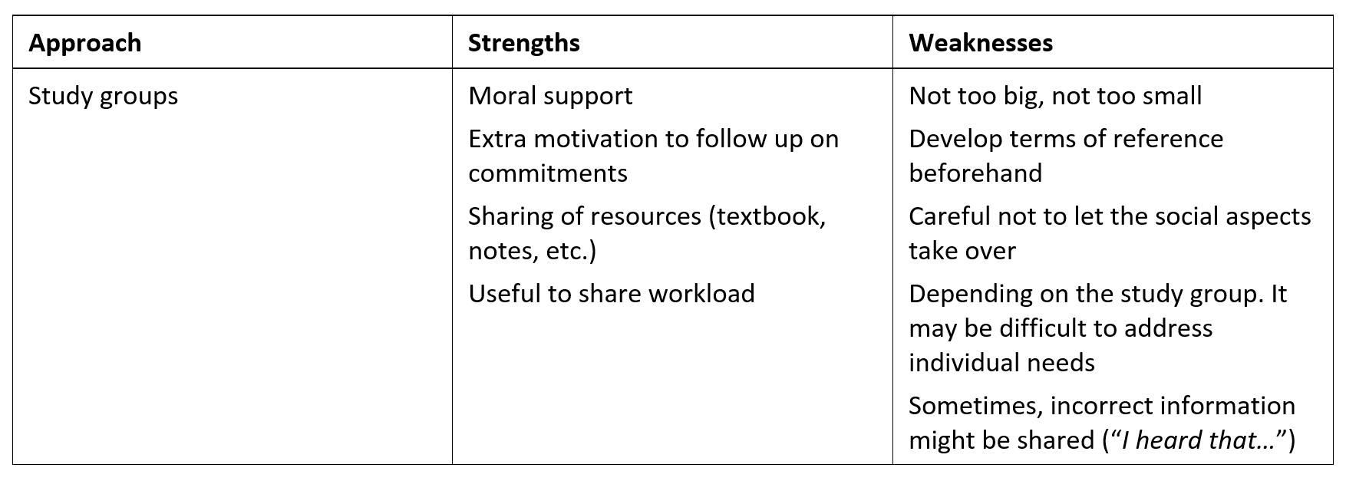
Study groups

Slide 30
One-on-one mentoring
Notes:
Recommendation here to have lots of caveats – worried that presenting this could look like you are getting insider information and they cannot violate the confidentiality agreement

Slide 31
College and universities test centres

Slide 32
Prep programs

Slide 33
What about writing exam questions and developing practice exams?
Writing exam questions is a learning experience in its own right. One begins to think (and read textbooks) like a question writer
Don’t develop an expectation that the ‘real’ questions will be like those you developed or that your performance on the real exam will be like your performance on practice exams

Slide 34
Advice #5: Develop or sharpen your multiple-choice test-taking skills
Your test-taking strategy should consider three aspects:
Processing multiple-choice questions efficiently
Pacing and stamina
Managing exam anxiety

Slide 35
Processing multiple-choice questions efficiently
All the usual advice
Read questions completely before answering
Eliminate options you know to be incorrect
There is no penalty for incorrect answers, guess from among options you could not eliminate
But there is also some advice out there that is not correct

Slide 36
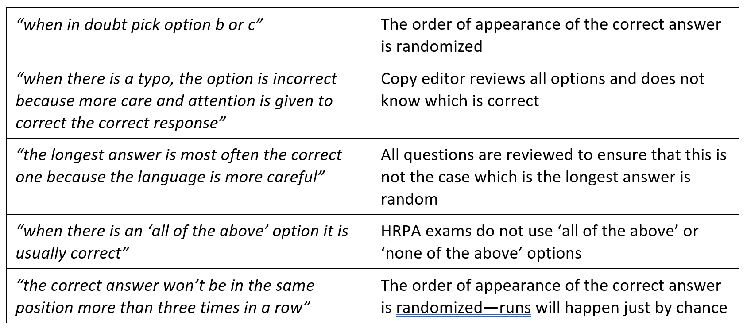
Don’t count on ‘tricks’ to answer questions

Slide 37
Pacing
Pacing—making sure that one gets through the exam within the time allotted
The CHRP-KE and CHRL-KE are designed to be ‘all power and no speed’—meaning that candidates should have no problem in completing the exams. Indeed, 95% of the candidates writing the CHRP-KE and CHRL-KE have no problem completing the exams within the time limits
The standard is one minute per multiple-choice question

Slide 38
Pacing
The advice here is to learn to pace oneself. For instance, if you have answered 30 question in the first half hour or 60 questions in the first hour, you know you are on track
Our computer-based exams, including the CHRP-KE And CHRL-KE, have a timer that counts down so you can pace yourself using this feature. Exam-writers also get 30, 15 min alerts
But this is an average, not a limit. It is OK to spend more time on a question because you will be spending less than one minute on other questions

Slide 39
Advice #6: Learn to manage exam anxiety
Exam anxiety is manageable
Maintain a healthy lifestyle
Get accurate information
Study effectively
Prepare to write the exam
Adjust your attitude
Change unhelpful thoughts
Use test-taking strategies
Use anxiety reduction techniques
Source: https://www.lib.sfu.ca/about/branches-depts/slc/learning/exam-anxiety/reducing-exam-anxiety

Slide 40
Advice #7: Remote proctoring or test centre
With remote proctoring come two new challenges ‘managing the test environment’ and ‘managing the technology’
Refer to the webinars on our website beforehand so there are no surprises on exam day

Slide 41
Whether remote proctoring or test centre
Read through the confirmation of registration email sent by HRPA and the appointment confirmation email sent by Prometric to ensure you aware of all exam rules and regulations along with the security procedures
Make sure you read all of it

Slide 42
Accommodations
HRPA will provide accommodations in regard to exams and provide candidates with fair access to the exam
By their very nature, accommodations are individualized
All the information, the policy and forms required to request an accommodation are posted on the HRPA website
Note that accommodations in a remote testing environment can present interesting challenges
If you require an accommodation, please let HRPA exam staff know as early as possible

Slide 43
Questions

