Slide 1
The Public Register
November 17, 2021

Slide 2
Claude Balthazard, Ph.D., C. Psych., CHRL
Registrar and Vice-president Regulation
Human Resources Professionals Association

Slide 3
ON24 Housekeeping
Attendees will be kept on mute throughout the entire presentation.
The event survey will be sent out 24 hours after today’s event.
Slides and recordings will NOT be emailed. A PDF of the slides can be downloaded from the “Resource Box”.
Please ensure your Media Player, Slides and Q&A box are open on your screen.
Please listen to the announcements for instructions on using the Q&A and Chat Box.
Please retain the access URL you used to join today’s webcast for on-demand viewing of the recording (up to 2 months post event).
Notes:
Even though all participants are on mute, we will be trying to make our session as engaging as possible and encourage you to share your questions and comments.
Technical questions can be submitted via the Q&A box. These questions and answers can not be seen by others in the audience.
Content related questions are encouraged through Group Chat. Questions, answers and comments made in Group Chat are seen by everyone. (If Group Chat is not being utilized for this specific event, then Content related questions are encouraged through the Q&A box).
We will take questions throughout if they’re relevant to the topic and answer any remaining questions at the end of the presentation.
The event survey will be automatically sent out 24 hours after today’s event.
The slide deck and recordings will NOT be emailed after the event.
Please retain the access URL you used to join today’s webcast for future on-demand viewing of the recording (up to 2 months post event).
The slide deck (if the speaker has granted permission to share) from today’s session is available to upload in the “Resource” box on your screen.
Please ensure your Media Player, Slides and Q&A box (and Group Chat box if being utilized for this event) are open on your screen.

Slide 4
Fall 2021 Webinar Series
October 27, 2021 | CHRP/CHRL Coursework Requirement Explained
November 3, 2021 | How to achieve the Certified Human Resources Executive (CHRE) Designation
November 10, 2021 | The Requirement to Notify the Registrar of Bankruptcies and Insolvency Events
November 17, 2021 | The Public Register: You are on it, you should know why
November 24, 2021 | Protecting Workplaces, Employees, and Employers from Risks of Harm: HRPA’s Shift to Risk-Based Regulation
Our previously aired regulatory and how-to webinar series can be found on the Professional Development page of our website.

Slide 5
Poll
In the last year, how many times have you looked up someone in the public register (including your own name)?
Not once
Once
Two to five times
Six to ten times
More than ten times

Slide 6
Agenda
The purpose of this webinar is to increase awareness and understanding of this aspect of our regulatory framework
Why do we have a register in the first place?
How long has HRPA had a register?
What information does the register contain?
Who decides what information should be on the register?
Can I chose to have my information not appear on the register?
What about privacy and privacy legislation?
How long does the information stay on the public register?
What does the ‘registration of firms’ refer to?
What happens if I find a mistake on my entry in the public register?
Are all registers the same?
How much use the HRPA register get?

Slide 7
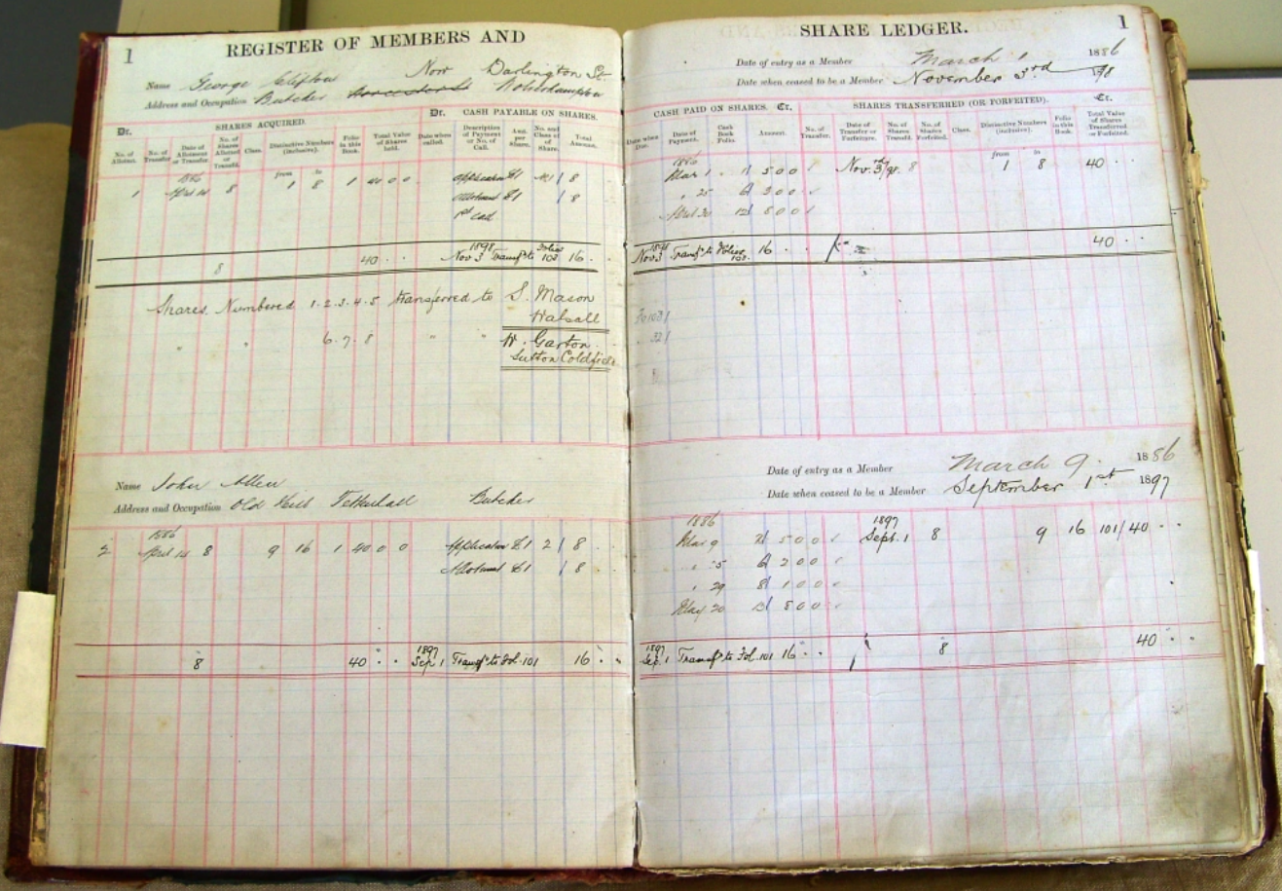
Registers used to be books in which were inscribed the names of members and other related information
Now, of course, registers are electronic databases
Professional regulatory bodies have made their registers available to the public online

Slide 8
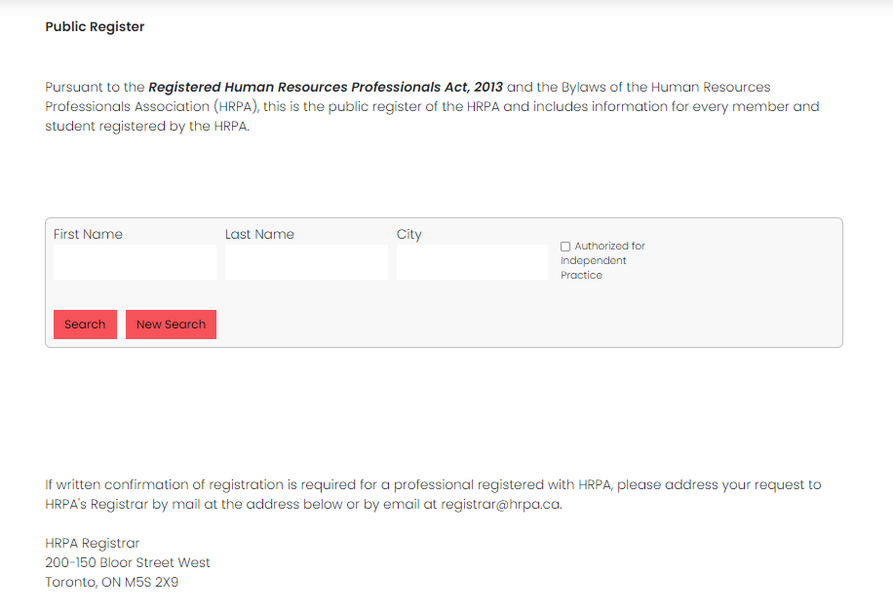

Slide 9
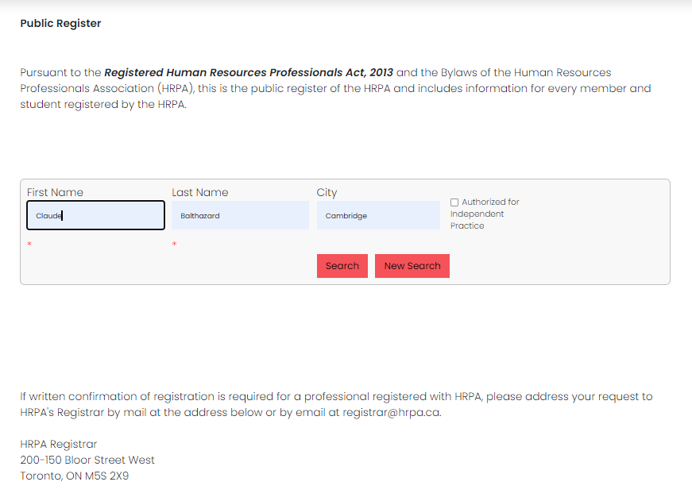

Slide 10
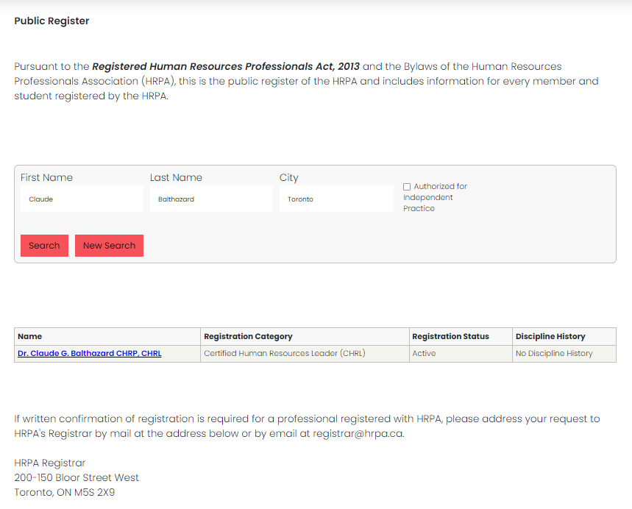

Slide 11
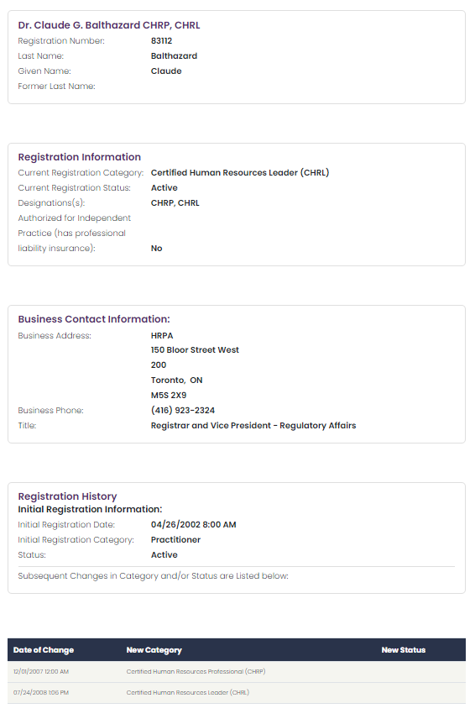

Slide 12
Some terminology: The Five ‘R’s
Register | The register is the list of HRPA members, firms, and students which includes all the information required by by-law to be on the register. A long time ago, the register was an actual physical register.
Registered | As in Registered Human Resources Professionals Act, 2013. Being registered means that one has met all the requirements for registration and that one’s name and other required information appears on the register.
Registrant | Any person or entity (aka. firm) that appears on the register is a registrant (not all registrants are members—firms and students are not members but they do appear on the register)
Registration | Registration is the process of placing a person or firm on the register.
Registrar | The Registrar is the person authorized in law to (1) establish and maintain a register, and (2) place individuals and firms on the register.

Slide 13
From the Registered Human Resources Professionals Act, 2013:
15 For the purposes of this Act and the by-laws, an individual is not a member of the Association unless the register indicates that he or she is a member.

Slide 14
Why do we have a register in the first place?
Answer #1
The register is an important component of professional regulation
Registers exist primarily for the benefit of the public (although it is also of benefit to registered professionals in that it provides a verifiable means of distinguishing oneself from non-registered practitioners)
Members of the public (i.e., users of the professional service) have a right to know basic information about the professionals who serve them
Members of the public (i.e., users of the professional service) have a right to know whether the professionals who serve them are registered (and thus accountable to a professional governing body)

Slide 15
Why do we have a register in the first place?
Answer #2
Because our Act requires us to do so
In fact, HRPA has been required to establish and maintain a register since 1990

Slide 16
How long has HRPA had a register?
The Human Resources Professionals Association of Ontario Act, 1990 (now obsolete) | The Registered Human Resources Professionals Act, 2013 (our current legislation)
5 (2) The Registrar shall keep a register in which shall be entered the names of all members of the Association in good standing, their status, and the categories of qualification to which any registration or certificate relates and within which any member has the rights and privileges of practice. | 60 (1) The Registrar shall establish and maintain a register of the members of the Association, firms and students, and the register shall contain the information required by the by-laws to be included.
5 (3) The register shall be open to examination by the public at the office of the association during normal business hours. | 60 (2) The register shall be open to examination by the public at the Association’s head office during normal office hours.

Slide 17
What information does the register contain?
The information that is to be contained in the register is specified in the By-laws:

Slide 18
What information does the register contain?
the names of all Members and former Members;
the Member’s class of Membership;
whether the Member is a Practitioner Member or Allied Member;
the Member’s Membership status;
any designation granted by HRPA;
any title granted by HRPA;
the Member’s date of initial Membership and the date of obtaining any certification granted by HRPA;
any dates after initial Membership or initial certification when the person was not a Member or did not hold the certification;
any dates after initial Membership when the Member’s Membership or was suspended or revoked and the reasons for the suspension or revocation;
the Member’s business contact information;
the name of any Firm through which the Member practices;
the business address and telephone number of each location at which the Member practices in Ontario;
whether the Member carries professional liability insurance;
such details as shall be necessary to protect the public where the Member has been found by the capacity committee to be Incapacitated,
the fact that a Member is under investigation, if the Registrar determines that there is a compelling public interest to disclose the information;
any restrictions or conditions on the right of the Member to practise in the field of human resources; and
any other information that the Member has agreed may be placed on the register.

Slide 19
Who decides what information should be on the register?
The contents are established by by-law
Which means that HRPA’s Board of Directors made the by-law and, subsequently, the by-law was ratified by the membership at the following Annual Meeting

Slide 20
Can I chose to have my information not appear on the register?
No, except in rare circumstances
Where there are legitimate fears for the safety of the individual. This would usually apply to the business address information and not the whole register entry.

Slide 21
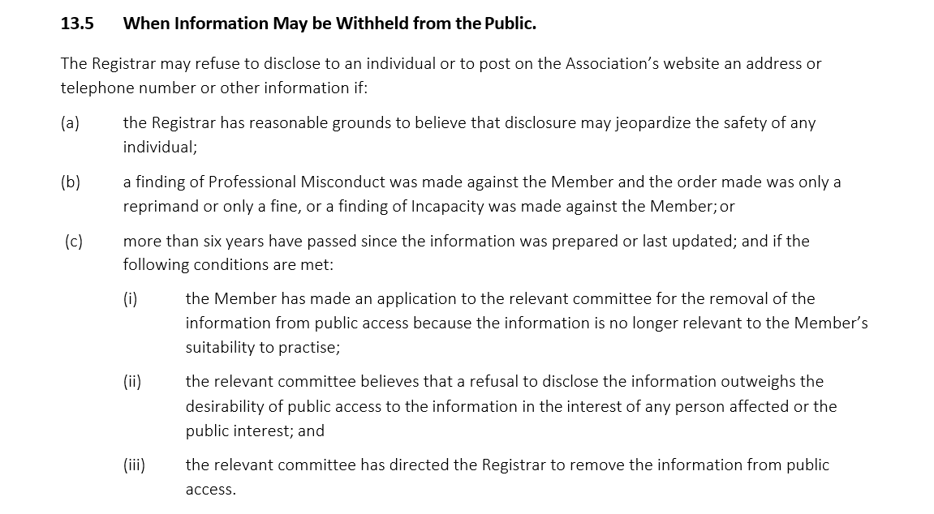

Slide 22
What about privacy and privacy legislation?
The courts have agreed that the right to privacy is not an absolute
The courts have stated that being a registered professional is a privilege and that this privilege comes with some loss of privacy

Slide 23
How long does the information stay on the public register?
The information remains on the register for 10 years even for individuals who cease to be registered with HRPA
As noted above, under some circumstances information may be removed after six years

Slide 24
What does the ‘registration of firms’ refer to?
The term ‘firm’ is often misunderstood
A ‘firm’ is a form of practice and includes sole proprietorships, partnerships, limited liability partnerships, and corporations
The reason why the Act includes the registration and regulation of firms was so that members and students would not be able to evade professional liability by practicing through a firm
The necessary by-laws have been passed to enable the registration and regulation of firms
The hold-up is the technology to enable the online register of firms

Slide 25
What happens if I find a mistake on my entry in the public register?
Just contact the Office of the Registrar and we will make the necessary corrections
As part of the registration renewal process, renewing members and students are requested to verify the information in their public register entry for accuracy
In fact, members and students are required to notify the Registrar of any change to information previously provided to the Association within 30 Days of the change

Slide 26
Are all registers the same?
Yes and no
The basic idea is the same, but the details are all a bit different
Check out your physician, dentist, or physiotherapist…
The trend has been to include more information on the register such as cautions and registrations with other professional regulatory bodies

Slide 27
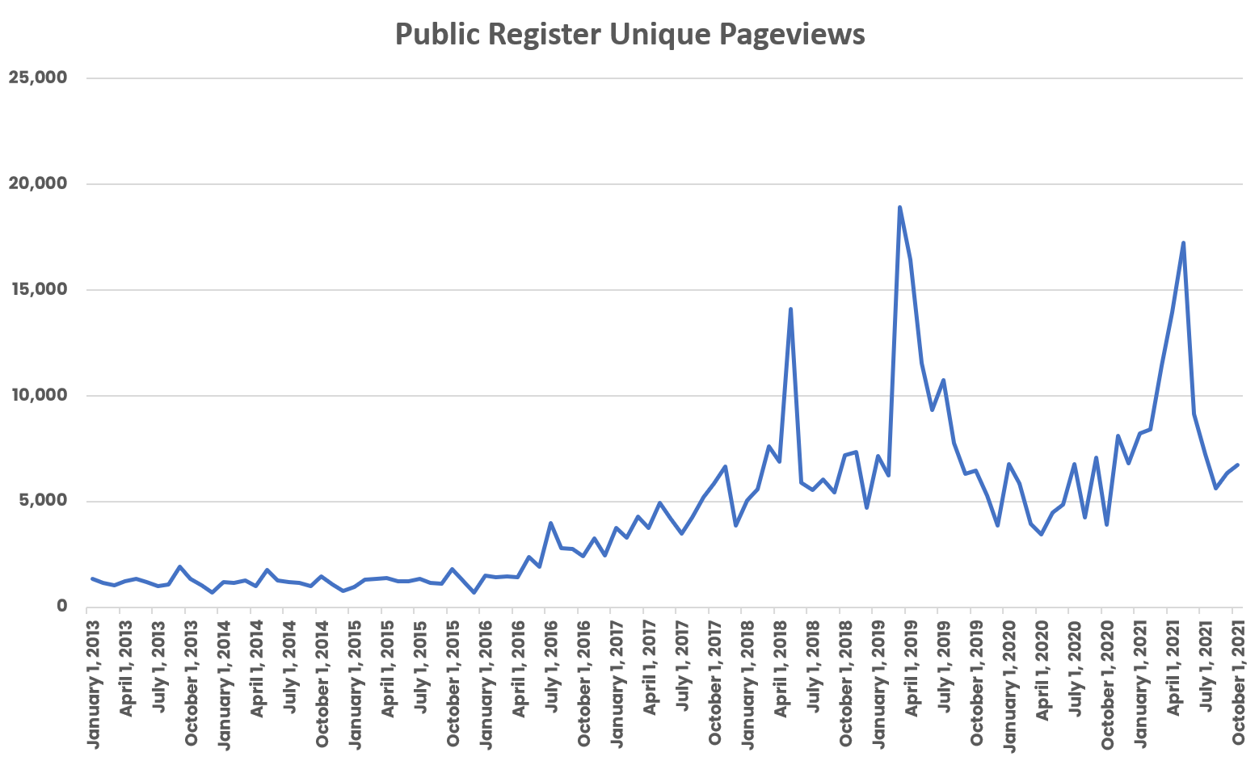
How much use the HRPA register get?

Slide 28
How much use the HRPA register get?
However, pageview information cannot distinguish between different kinds of visitors. For instance, pageview information cannot distinguish between public register visits by HRPA registrants looking up their own, by HRPA staff in responding to enquires, or by the public wanting to look up the registration status of a human resources professional

Slide 29
How much use the HRPA register get?
The register gets about 6,500 visits on any given month
This corresponds to about 300 visits to the public register on any given day

Slide 30
Questions
Comments
Ideas

Slide 31
Thank you for participating today

